Slide 1


Interview for PhD Application
Interview Presentation
自行替换学校
自行替换学校
Applicant:
1 September 2023
Ctrl + 鼠标滚轮 = 放大缩小
右键单击左侧缩略图 → 版式 → 选择【封面-1】

Slide 2
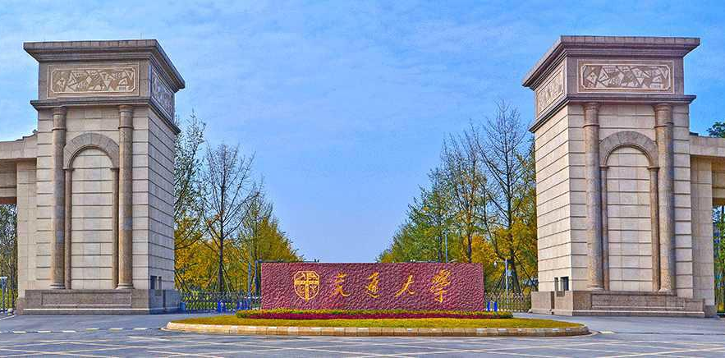
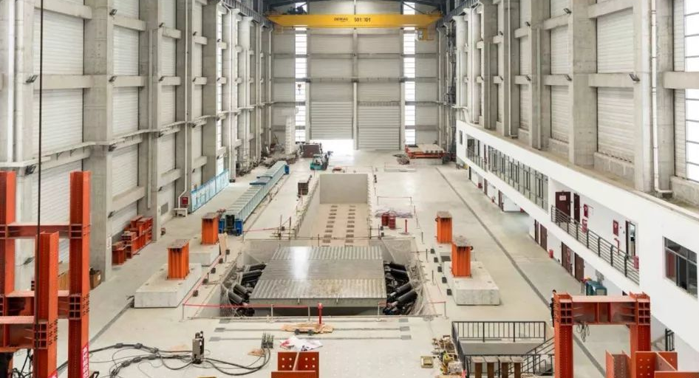
选中图片→ Delete → 点击图标，即可更改图片
1.Background 2.Research Experience 3.Future Plan 4.Skills
(Leo) 丨 1999.03 丨 Chongqing, China
Educational Background
University Chengdu, China
Master of Science in Tunnel Engineering (Supervisor: Prof.)
GPA: /100 09/2021 – present
University Chengdu, China
Bachelor of Science in Civil Engineering
GPA: /100 09/2017 – 06/2021
Core Courses:
Soil Mechanics(89), Underground Railway(89), Mountain Tunnel (82)
Underwater Tunnel(84), Geological Civil Engineering(89)
Awards
The Special Prize Scholarship in 2022 (top 10%)
The First Prize Scholarship in 2021 (top 15%)

Slide 3
选中图片→ Delete → 点击图标，即可更改图片
1.Background 2.Research Experience 3.Future Plan 4.Skills
Project 1:
07/2022-Present Team leader
Research Background and Method
Dynamic loads
(JCR: Q1, IF: 7.144)

Slide 4
选中图片→ Delete → 点击图标，即可更改图片
1.Background 2.Research Experience 3.Future Plan 4.Skills
Project 1:
The relationships
(JCR: Q1, IF: 7.144)

Slide 5
选中图片→ Delete → 点击图标，即可更改图片
1.Background 2.Research Experience 3.Future Plan 4.Skills
Project 2:
11/2021-Present
Developed
Utilized
The deformation
The mechanical
Study on
Railway Standard Design.

Slide 6
选中图片→ Delete → 点击图标，即可更改图片
1.Background 2.Research Experience 3.Future Plan 4.Skills
Project 3:
.
Journal of Safety Science and Technology.
Railway Standard Design.

Slide 7
选中图片→ Delete → 点击图标，即可更改图片
1.Background 2.Research Experience 3.Future Plan 4.Skills
Research Interests
Research Proposal
1
2.

Slide 8
选中图片→ Delete → 点击图标，即可更改图片
1.Background 2.Research Experience 3.Future Plan 4.Skills
Skills
Self-assessment
Well-motivated
Diligent
Analytical
Inquisitive

Slide 9
Thanks!

